Slide 1
Sign Language Detecting App
USER MANUAL
AUTHOR: YOGA VAISHNAV.M

Slide 2

Table of Contents
Acknowledgments
About Me
About My Internship Journey with Clevered
About the App
How to use the App
Contact

Slide 3
Acknowledgements
There are People without whose help, I would not have been able to develop this app:
My Parents, My Mentors and Mr. Ken.
I am very grateful to them for helping me through this journey. Thank You.

Slide 4
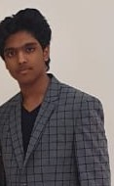
About Me..
My name is Yoga Vaishnav. I am 16 years old
and am studying in 12th grade.
I am interested in Artificial Intelligence due to
the infinite amount of algorithms and
applications in it. I want to learn more,
Develop apps and do things that will make a
Positive impact in this world

Slide 5
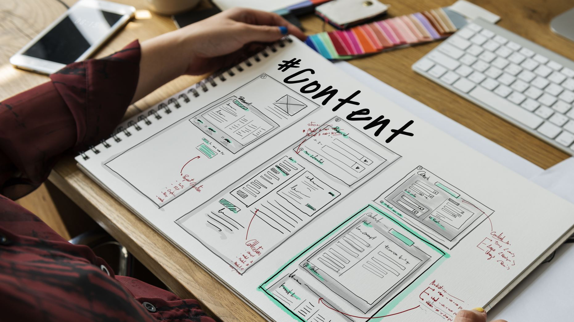
About My Internship Journey with Clevered..
I have had a great experience throughout the sessions I have
done with clevered. I have learnt a lot of things during these
sessions: How does machine learning and deep learning work,
how to develop a program using deep learning, how to
develop a user interface for an app so that it looks good and is
easy to use etc...
The internship was hard but I finally was able to Pull through and make this app.

Slide 6

About App..
I chose to make this app because it will help people communicate with Disabled People.
This app will process the image that is uploaded by the user and predict the ASL alphabet that is in the image.

Slide 7
How do I use the App?

Slide 8
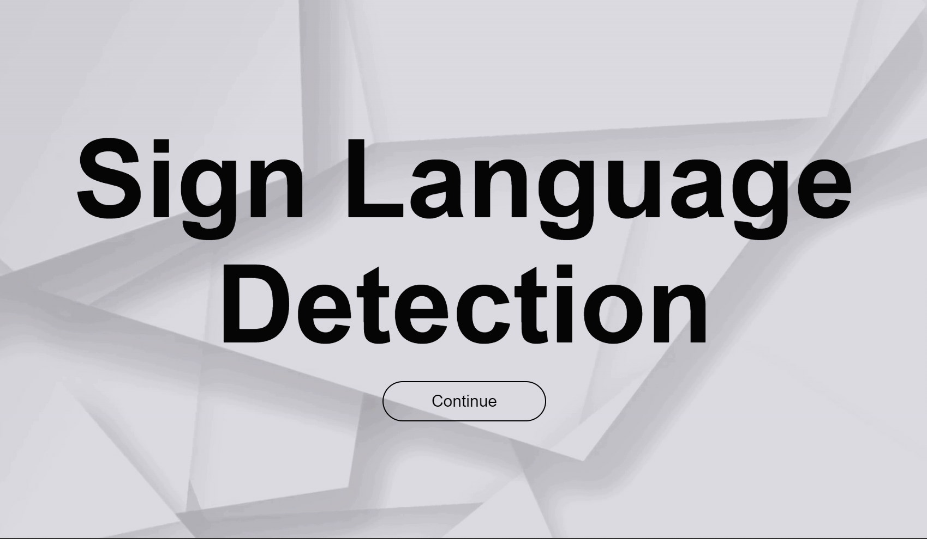
Home Page
This is the home page where you will be able to find the button 'continue'.
When clicked it will redirect you to the page where the app is actually located

Slide 9
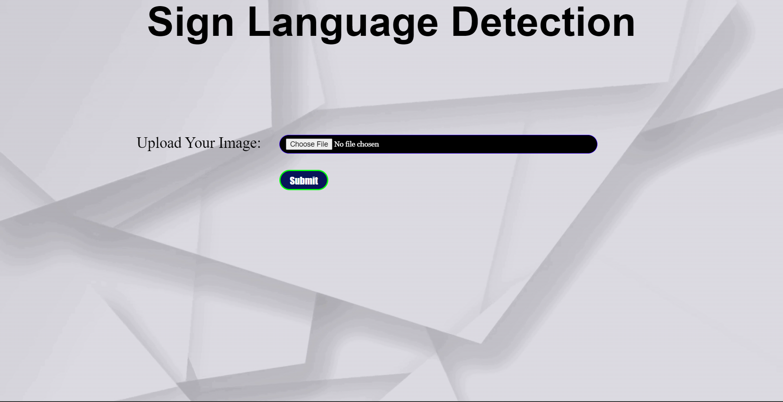
The Main Page
This is the page where the app is located. When directed to this page. Click on choose file to choose the file which u want predicted.

Slide 10
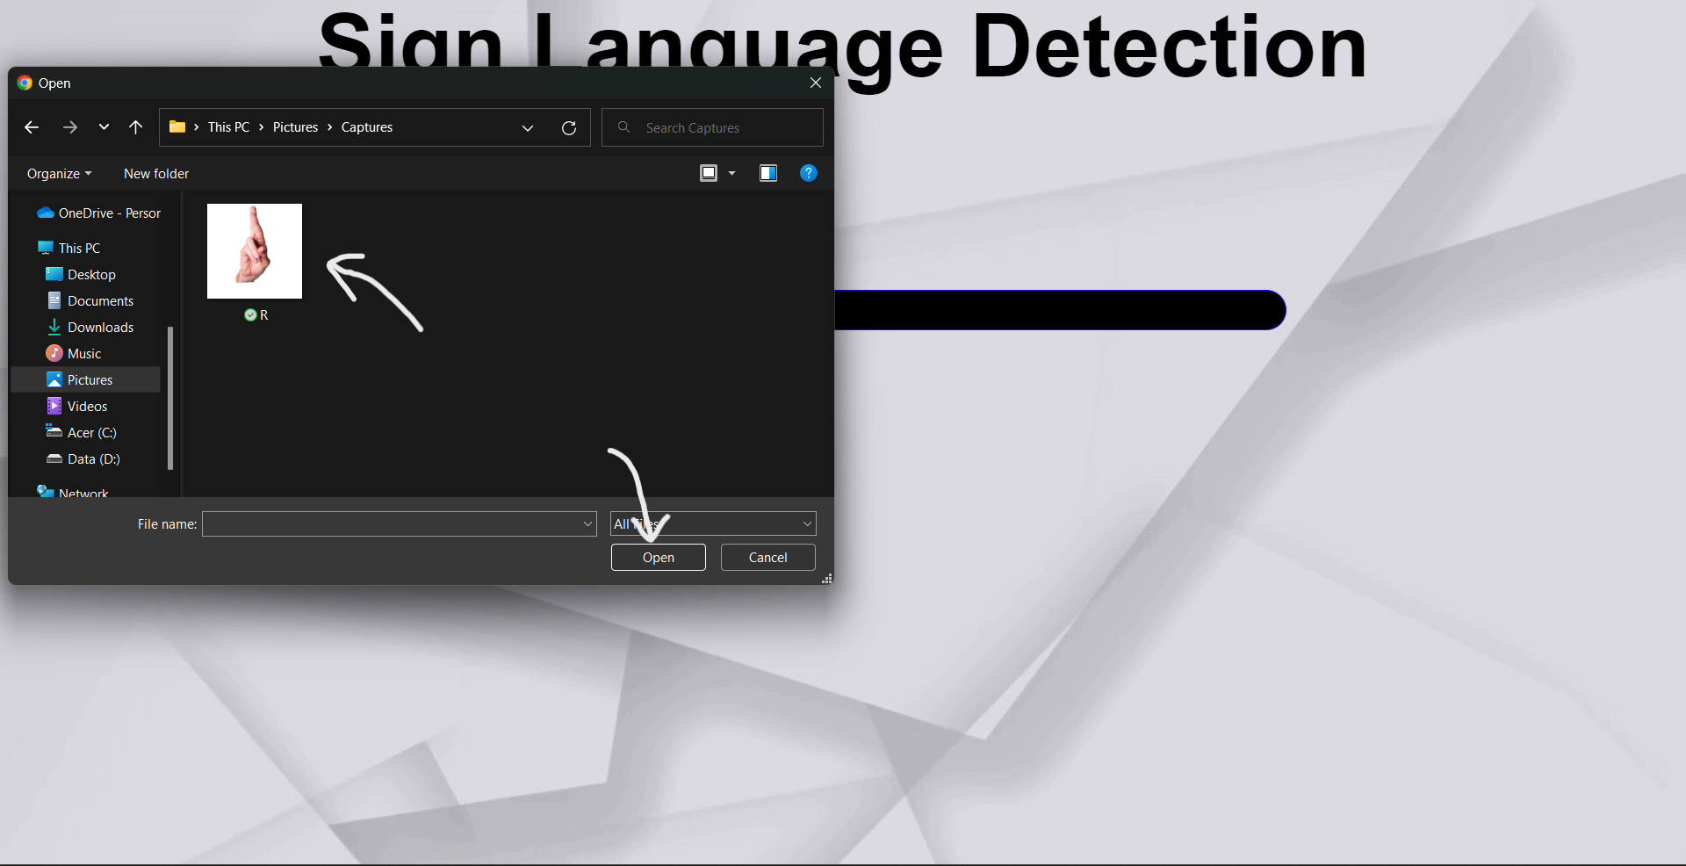

Slide 11
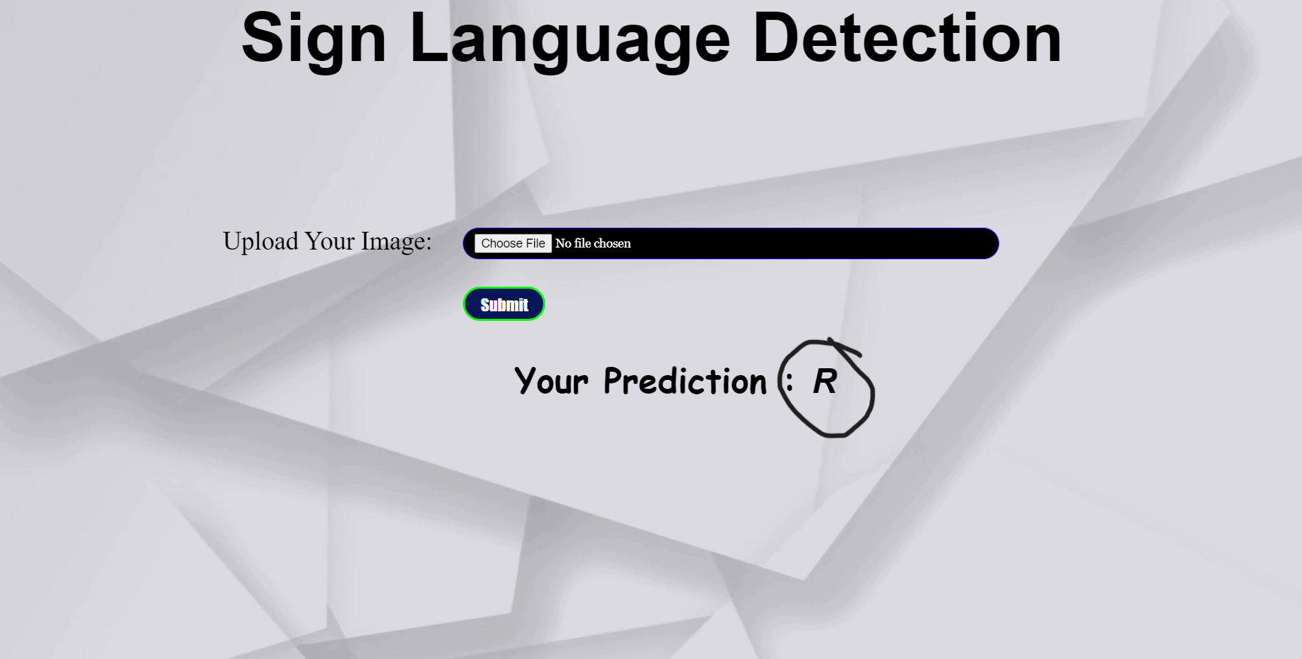
After selecting your image, click on submit.
After submitting you will find the prediction on the bottom of the screen

Slide 12
CONTACT
PLEASE REACH OUT TO YOGA VAISHNAV AT
vaishnav.mandru@gmail.com
FOR ANY QUESTIONS/CONCERNS/SUGGESTIONS ON THE APP

Slide 13
THANK YOU

